Slide 1
Cyclistic Capstone Project
Analyzing Casual vs. Member Rider behavior Using Python
Charles Gray | Data Analyst | 5/22/2025

Slide 2
Executive Summary
Cyclistic’s goal is to convert casual riders into annual members.
This project analyzed 12 months of 2023 ride data using Python (pandas, seaborn) to uncover differences in behavior between rider types.
Key insights support 3 actionable recommendations to help drive membership growth.

Slide 3
Data Overview
• Source: Divvy bike-share trip data (https://divvy-tripdata.s3.amazonaws.com/)
• Timeframe: January – December 2023
• Total records analyzed: 5.7 million+
• Tools: Python (pandas, matplotlib, seaborn)
• Key fields: ride_id, rideable_type, started_at, ended_at, member_casual

Slide 4
Data Cleaning
• Combined 12 monthly CSV files using pandas
• Converted timestamps to datetime
• Created ride_length_minutes and day_of_week columns
• Removed rides with negative or 0 duration

Slide 5
Key Insights
1. Casual riders take longer rides than members on average
2. Casual riders ride most on weekends; members are more active on weekdays
3. Casuals prefer electric bikes more than members

Slide 6
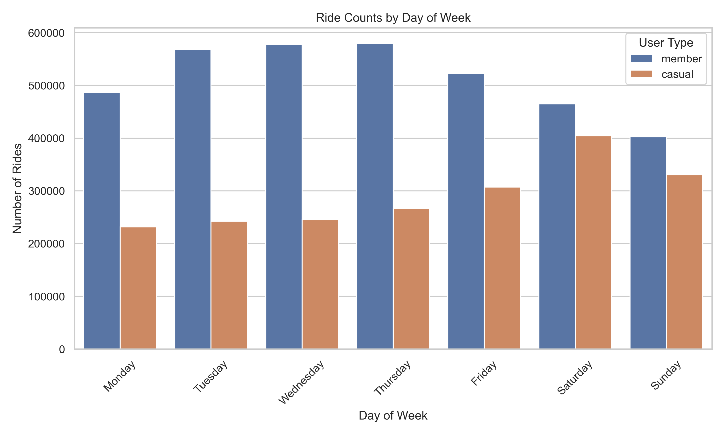
When Do Riders Use Cyclistic Bikes?
Casual riders show clear spikes on weekends, especially Saturdays and Sundays. Members ride more consistently during the weekdays, indicating use for commuting or routine travel.

Slide 7
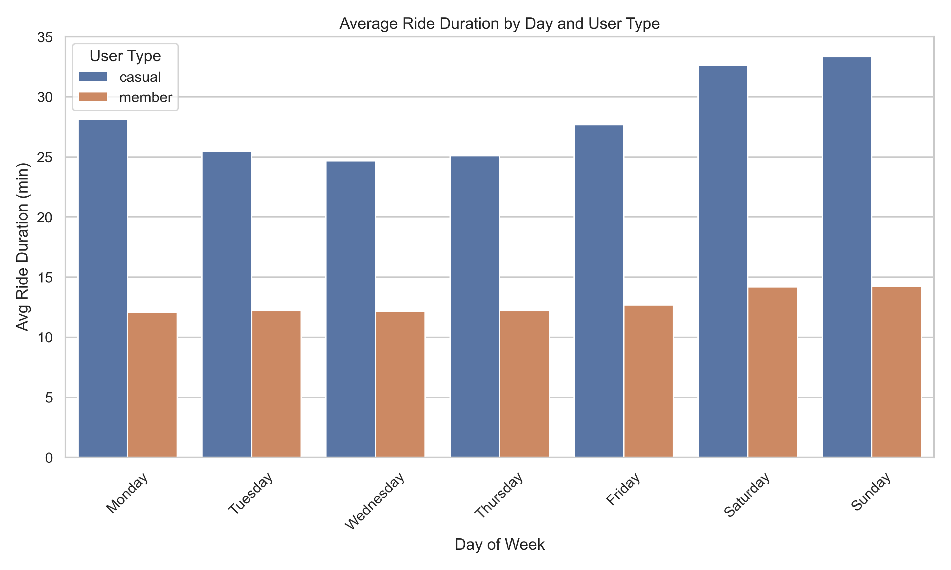
Who Rides Longer- and When?
Casual riders take significantly longer rides than members on average — especially on weekends. Members' ride durations remain steady and shorter, aligning with practical transportation behavior.

Slide 8
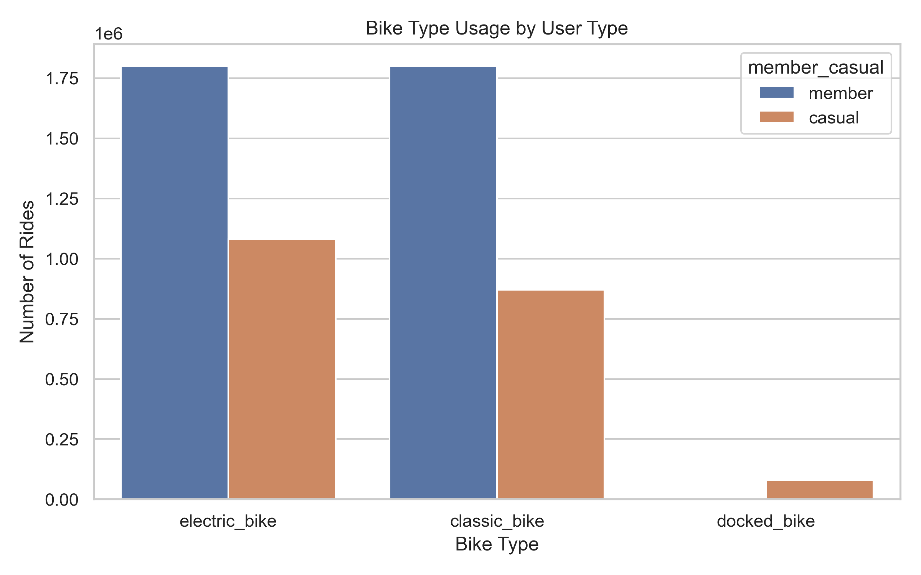
What Bikes Types Do Riders Prefer?
Casual riders are more likely to choose electric bikes, suggesting a preference for speed and leisure. Members use classic and docked bikes more evenly, consistent with routine, cost-conscious usage.

Slide 9
Recommendations
Offer Weekend Trial Memberships With Weekday Perks
Insight: Casual riders peak on weekends and take longer rides Strategy: Launch a weekend-only trial membership that promotes weekday commuting benefits to casual users. Include messaging like “Unlock weekday savings!” to encourage conversion.
Launch Seasonal Campaigns During High-Casual Periods
Insight: Casual usage spikes in warmer months and weekends Strategy: Run promotional campaigns in spring/summer targeting weekend riders. Offer limited-time discounts, referral bonuses, or family-friendly bundles to drive membership conversion.
Bundle Electric Bike Access Into Membership Tiers
Insight: Casual riders prefer electric bikes significantly more than members Strategy: Create or highlight a membership tier that includes unlimited or discounted e-bike usage. Market it as a premium experience that saves money for regular riders.

Slide 10
Closing/ Call to Action
This analysis supports a data-informed membership strategy.
Let’s test campaign messaging targeted at casual rider habits — and measure conversion over the next quarter.
Thank you!

